Slide 1
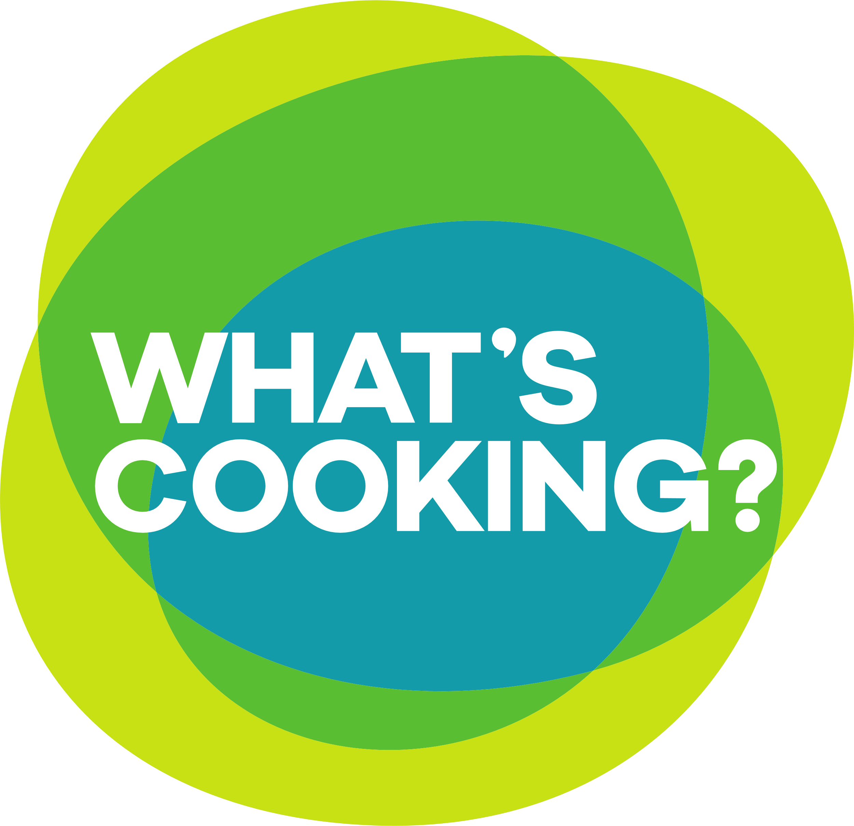
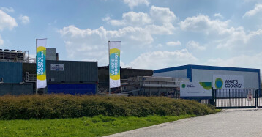
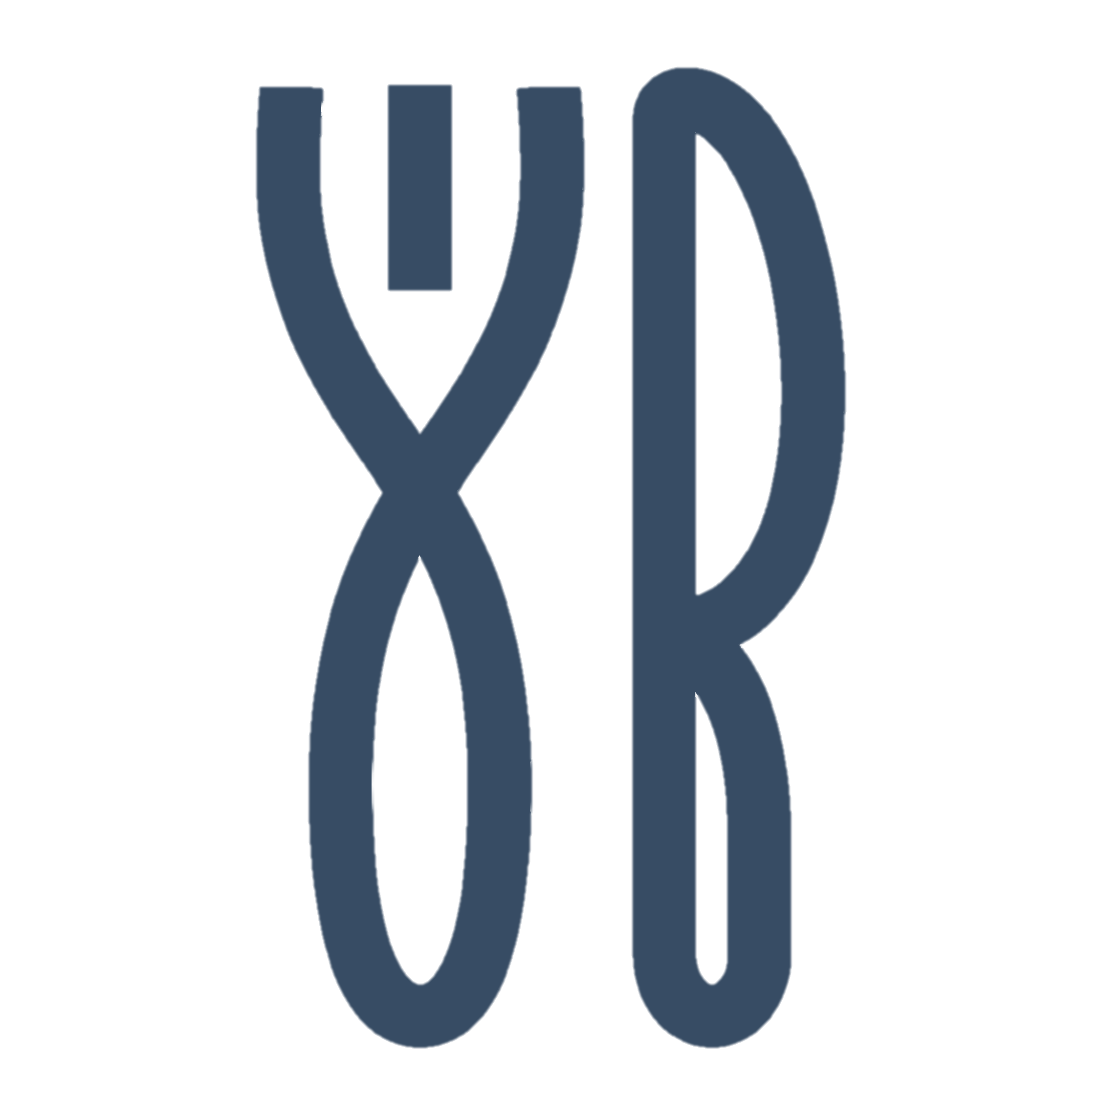
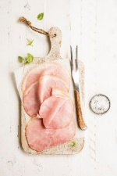
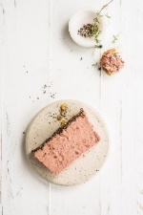
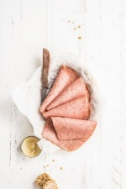





What's Cooking? inaugurates innovative water reuse plant
Our portfolio in Savoury factory Wommelgem
  Every day, we produce, slice, package and
  label amazing tasting cold cuts.
  Our consumers are in for a treat,
  with fresh savoury slices that look like
  they were cut on the spot.
Our ambition as part of our sustainability strategy
  What's Cooking wants -30% water consumption per tonne of product sold by
  2030.
  100% green electricity from 2024
  SBTI committed
Facts & figures
What's Cooking Wommelgem NV
Part of: What's Cooking?
Location: Wommelgem (Antwerp)
Employees: 345 out of 2,500 within the Group
Surface area: 55,000 m²
Turnover WHATS : 832 mio € (+/- 50% Savoury)
# sku’s: 250
# of recipes: 125
Volume: > 17,000 tonnes of production
> 10,000 tonnes slicing
Investment against water scarcity
  Partnering with Eco-Vision in Wommelgem in water reuse plant.
  This innovative installation provides 50% less wastewater and
  consequently 50% less need for groundwater pumping.
  30m3/h or one olympic swimming pool every 10h; Comparable to 110,000 m³ of water or the total annual consumption of 1,600 households.

Slide 2
Press event

